Slide 1

Raspberry Pi Headless Setup
Presented By:
Jitender Kumar
M.Tech. (Embedded Systems)
Batch(2016-18)

Slide 2
Table of content
Introduction to Raspberry Pi.
Raspberry Pi Zero W.
Installation of Pre-requirement.
Raspbian OS.
Write Raspbian OS into the SD card.
Headless Setup through Ethernet Cable.
Static IP over Ethernet.
Headless Setup through Wi-Fi.
Static IP over Wi-Fi.
JuiceSSH Android Application.

Slide 3
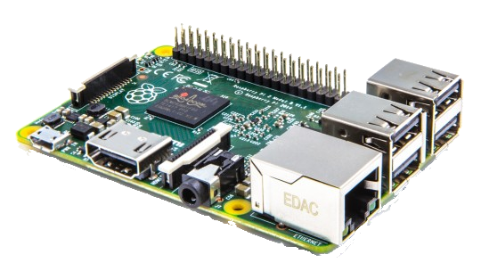
Introduction to Raspberry Pi
Pi is small scale computer developed in United Kingdom by Raspberry Pi foundation.
can be used as a cheap computer for experiments and education purposes.
based on Broadcom SoC (System on Chip) with an ARM processor.

Slide 4
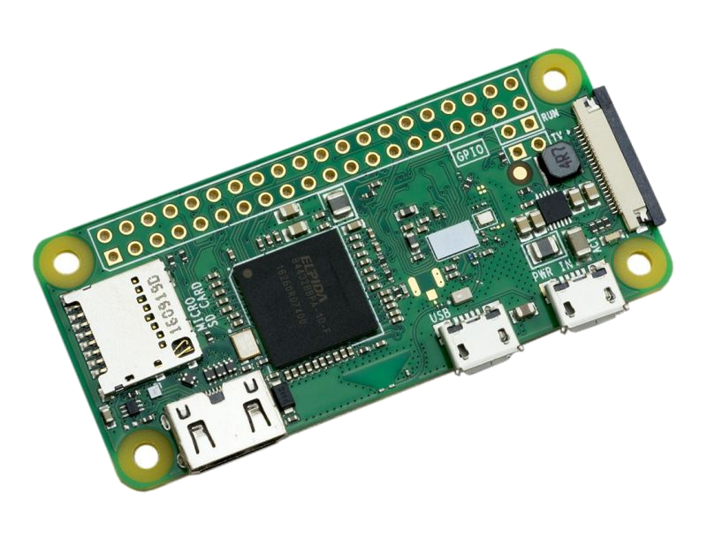
Raspberry Pi Zero W
Launched at the end of February 2017.
It consist :
1GHz, single-core CPU
512MB RAM
Mini HDMI and USB On-The-Go(OTG) ports
Micro USB power
HAT-compatible 40-pin header
CSI camera connector
802.11 b/g/n wireless LAN
Bluetooth 4.1

Slide 5
Installation of Pre-requirement
Nmap : To install nmap type the command given below on Ubuntu terminal and pressed enter.
sudo apt-get install nmap
PuTTY : To install PuTTY type the command given below on Ubuntu terminal and pressed enter.
sudo apt-get install putty
Configure Wi-Fi Hotspot.

Slide 6
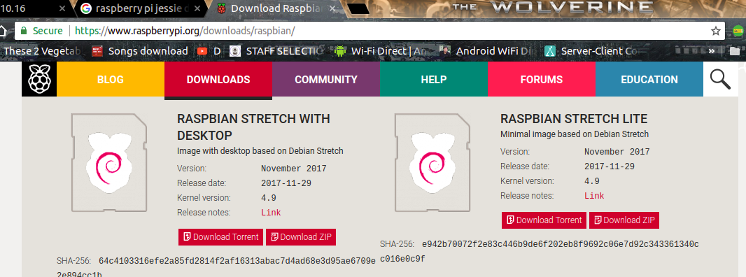
Raspbian OS
Download the raspbian-stretch-lite from the official website of Raspberripi.

Slide 7

Write Raspbian OS into the SD card
First download the Raspbian-Stretch-lite(OS) zip file from official website of Raspberry Pi and extract it.
Write the image in SD card using terminal command given below.
dd bs=4M if=<source_file.img> of=<destination>

Slide 8
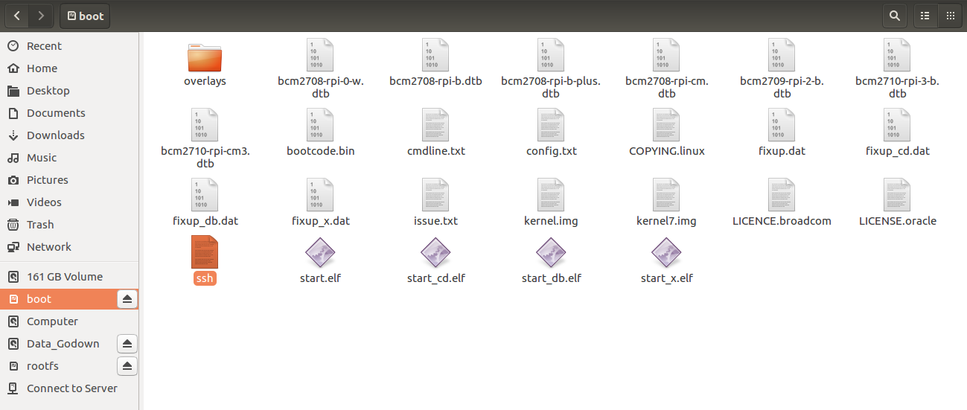
Enable SSH
First step is to enable SSH.
To enable ssh we have to create a file named “ssh” in boot partition without any extension. Now remove the SD card.

Slide 9
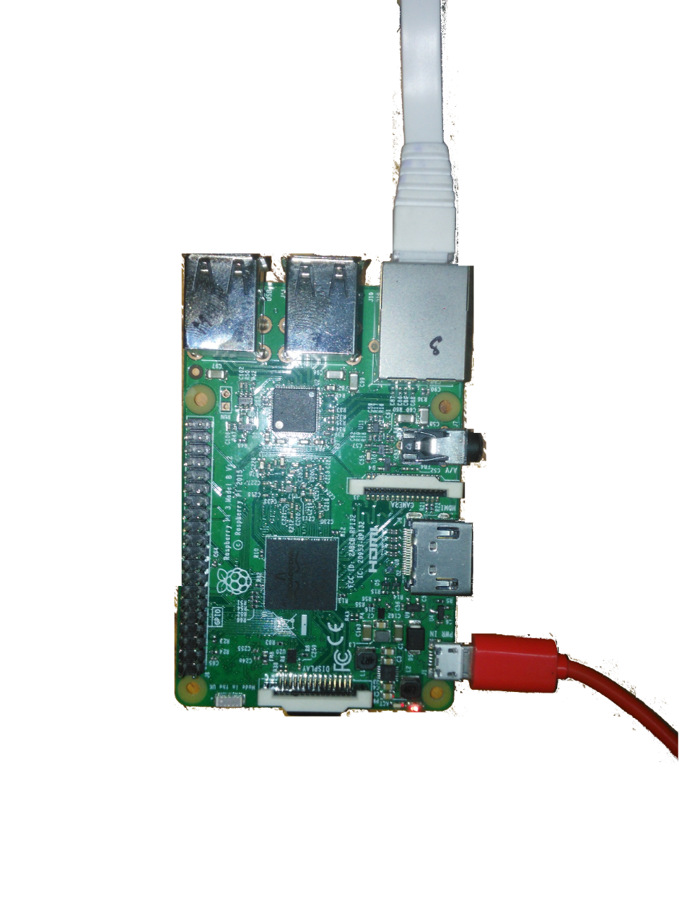
Headless Setup through Ethernet Cable
Headless means setup without using additional desktop, keyboard and mouse.
Insert the SD card into the RPi.
Connect the Ethernet cable to your laptop/PC.
And finally connect the 5V micro-usb adapter to power up RPi.

Slide 10
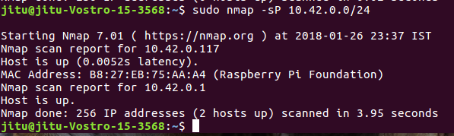
Headless Setup through Ethernet Cable…
Now by using nmap tool we obtain the IP address of Raspberrypi.
Type the command given below in your terminal and pressed enter.
This command will give you the details of connected RPi.

Slide 11

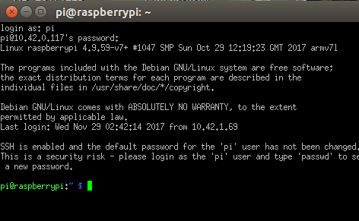
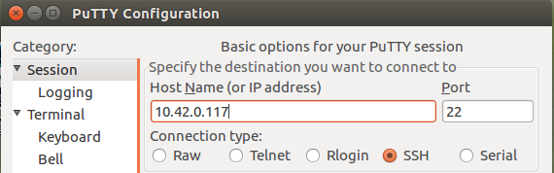
Headless Setup through Ethernet Cable…
Now type the hostname or IP address of RPi into the box and press OK.
A new window is open asking the “login” and “password” details.
Default login is “pi” and the password is “raspberry”.

Slide 12
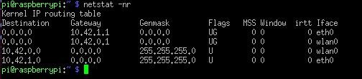
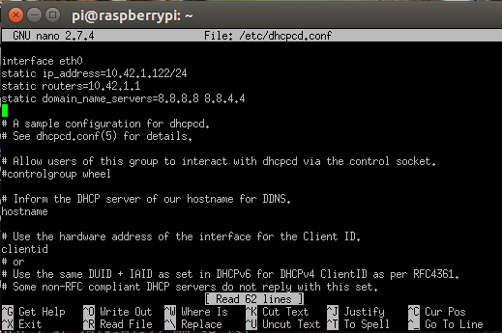
Steps to configure static IP over Ethernet
Now run command “netstat -nr” and note down the gateway id.
Now open “dhcpcd.conf” file using terminal command edit the file.
sudo nano /etc/dhcpcd.conf
To save this file press ‘ctrl+o’ and hit enter.
Now static IP is assigned to the RPi.

Slide 13
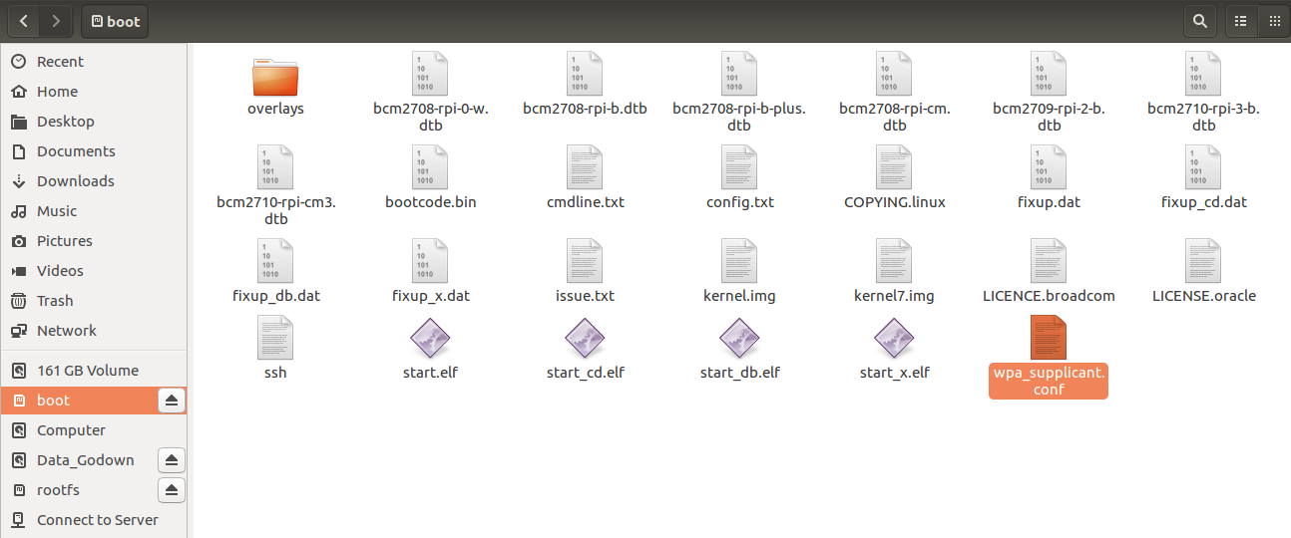
Headless Setup through Wi-Fi
As SSH is already enabled so there is no need to enable it again.
Create a file named “wpa_supplicant.conf” into the boot partition

Slide 14
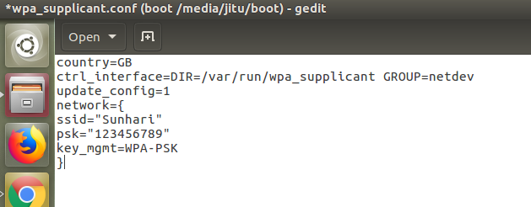
Headless Setup through Wi-Fi…
Now edit the wifi credentials into the “wpa_supplicant.conf” file and save it. Remove SD card and insert in RPi.
Now using nmap command find the IP address of the RPi.

Slide 15

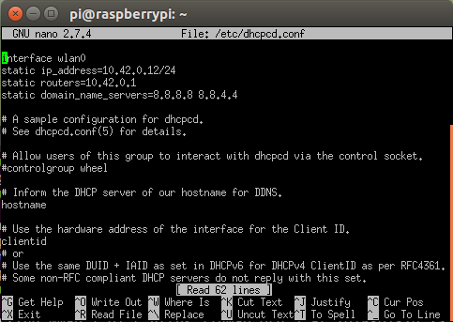
Steps to configure static IP over Wi-Fi
Now run command “netstat -nr” and note down the gateway id.
Now open “dhcpcd.conf” file using terminal command edit the file.
sudo nano /etc/dhcpcd.conf
To save this file press ‘ctrl+o’ and hit enter.
Now static IP is assigned to the RPi.

Slide 16
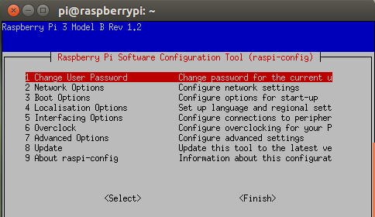
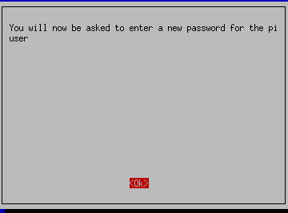


Changing the password
First type the command “sudo raspi-config” in pi terminal.
A window is pop up. Select option 1 and press enter. You will now be asked to enter a new password for the pi user. Now you can change the password.

Slide 17
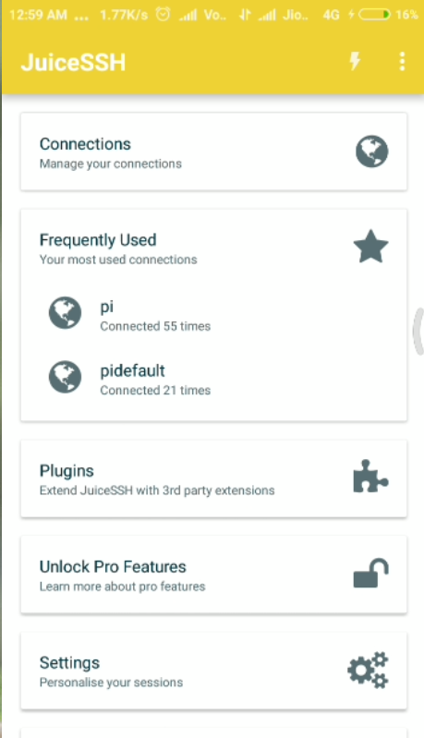
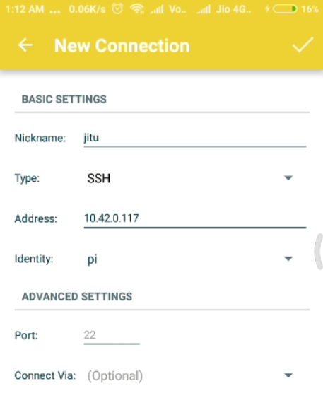
Accessing RPi terminal using Android App
Download the “juicsSSH” app from playstore.
Open app and tap on Connections.
In connection tap on ‘+’ icon given below.
Add the IP address of your RPi into the ‘Address’ text box.
Now Tap on ‘identity’ and select ‘new’ from the drop-down menu.

Slide 18
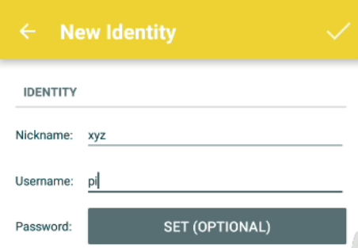
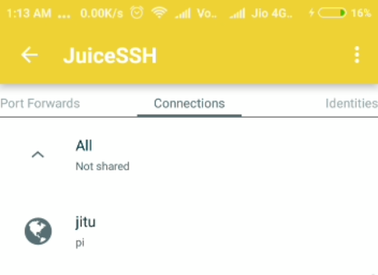
Accessing RPi terminal using Android App …
Provide ‘pi’ as Username and tap on ‘tick’ symbol on the top right corner.
Now you will see your username.
Tap on username and it will start connecting to the given RPi.

Slide 19
Thank You

